Slide 1
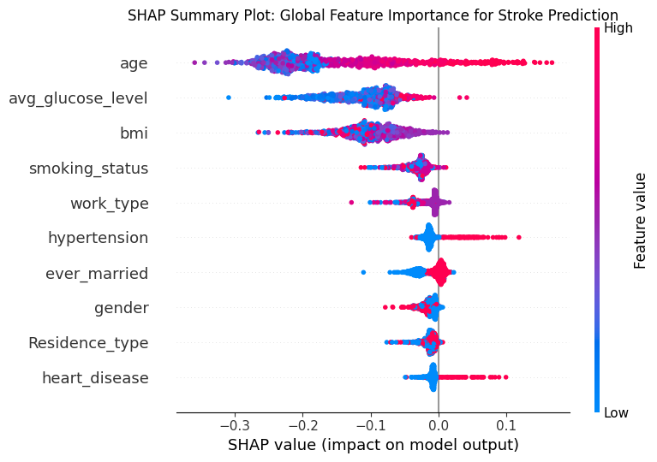
As a Data Scientist
Model Performance & Explanation of Stroke Classification
Architecture: Random Forest Classifier (80/20 split).
Target: Stroke = 1 (Probability scale).
Metrics: 0.00% Recall | 50.00% Balanced Accuracy.
Top Predictors: Age, Glucose, BMI.
Methodology: TreeExplainer utilized for exact Shapley values.
Limitation: 6% positive prevalence caused minority class collapse. Reliability is unproven; resampling required.

Slide 2
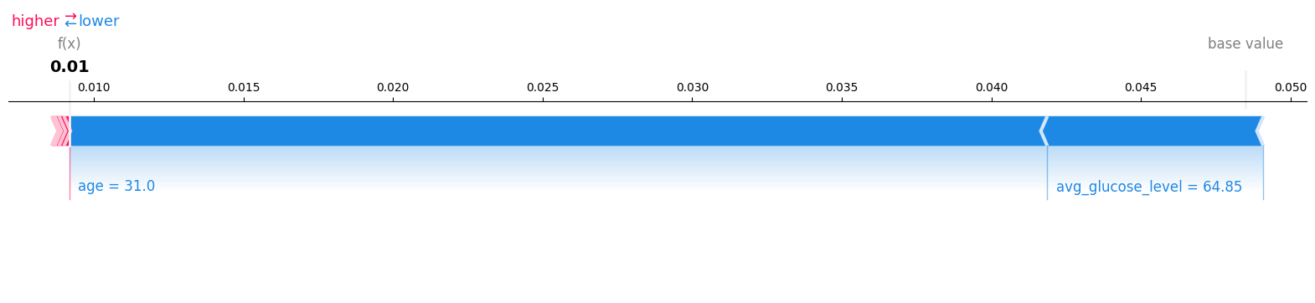
As a Doctor
CLINICAL REVIEW
Interpreting One Patient Prediction in Clinical Context
Patient Index 0 Output
Clinical Cautions
Predicted probability: 1.0%. Downward statistical pressure driven by young age (31) and normal glucose (64.85).
Model sensitivity is 0% (misses all true positives). Retrospective data lacks external calibration. Attributions are non-causal.

Slide 3
As a Patient
What the computer prediction means for you
The computer reviewed your recorded health information and estimated your stroke score to be very low (1%).
Factors lowering your estimate
Important Context
• You are young (31 years old).
This is a statistical guess, not a medical diagnosis. The computer can be wrong and sometimes misses actual cases.
• Your blood sugar levels are normal.
Your doctor will review this estimate alongside your full health history to make the best decisions with you.

